Slide 1

FTS (Follow the Sun) Tool
Data Movement
*
*
*
Transfer Management Tool in CRM/VDM

Slide 2


What is the FTS Tool?
FTS Tool is a Transfer Management Tool in CRM/VDM that can be used simplify and optimize case handoff procedure.
How does it work?
1. Regional Coverage/Responsibility Times are recorded in CRM.
2. FTS tracks all cases that are Sev A or 24x7 at the end of a region’s coverage .
3. FTS aggregates these cases into a list for review by Assignment Lead/TA
4. Provides tool for engineers to request transfer/report why a case needs to be transferred.
5. Tracks/Reports all transfers globally and provides metrics.

Slide 3
Why move to FTS?
Automation of handoff process, rather than a manual process.
Reduction in transfers – teams who have moved to FTS have seen reductions in transfers between their regions.
Reduction of time in handoff calls – FTS aggregates cases automatically, so there is less back and forth needed from engineers and leads.
Automation of handoff best practices – FTS promotes appropriate handoffs, handovers to engineers who have previously owned a case, and automated handover using VDM.
Accurate transfer trend reporting.
Promotes proactive handoff mentoring/assistance by pre-reporting potential handover cases.

Slide 4
Impact of FTS to Current Process:
Minimal
Changes Needed:
Engineers will use FTS form rather than teams transfer list to move cases.
TAs/Assignment leads will use FTS tool to review cases and handoff.
1 hr training + wiki article should cover this transition.
Otherwise handover process is exactly the same as current.

Slide 5
What does this mean for
Support Engineers
Updates to process:
Cases need to be correctly marked with Severity, Region, and 24x7 availability to move through the tool.
Fill out FTS form for any transition that needs to be made, rather than filling out Teams form.
Will only need to discuss handoff if handover SME/TA has questions.

Slide 6
What does this mean for
TAs/Assignment Leads
Updates to process:
FTS will aggregate a list of cases that are likely going to be handed over (based on state and severity) and cases that need to be handed over, which Leads and proactively review.
Leads will approve handovers for these cases, and FTS will automatically assign an engineer in the next region using VDM.
Leads only need to work with engineers handing off if there are questions.

Slide 7
What does this mean for
Managers
Updates to process:
Handover metrics will no longer be housed in teams, they will instead be housed within CRM/VDM.
Access to specific metrics about how many cases are being handed over per region.
Engineers will need to be correctly added to regions in VDM, and regions and handover calls will need to be added to VDM to support the FTS tool.

Slide 8
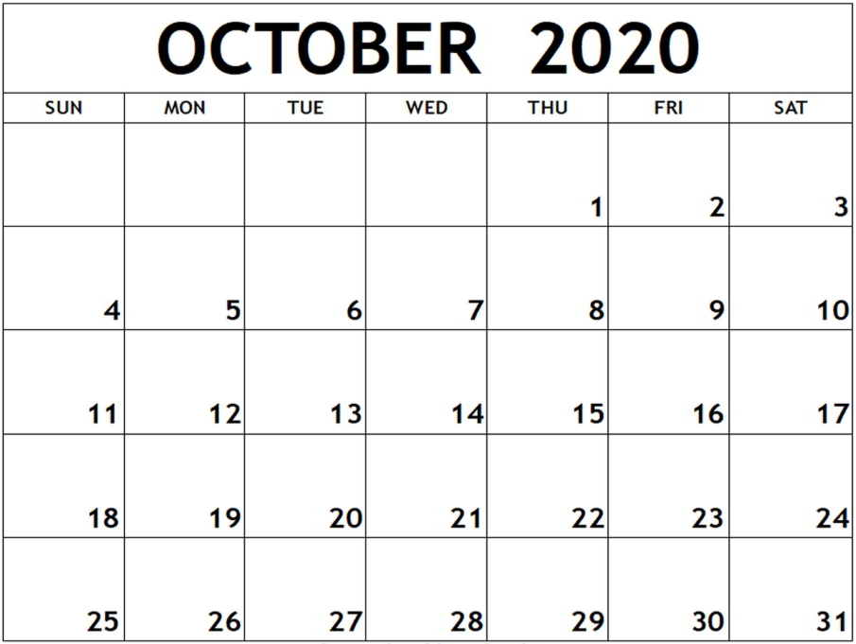
Timeline to Go Live
October 6th – Beta Testing
October 7th-9th – Training for SEs and Leads
October 13th – Go Live!
October 13th – 16th – Live week Setting up and close
monitoring of FTS

